Slide 1
MUNIYAMA – SOVRYN CHAIN DATA API
Naveen V

Slide 2
AGENDA
Introduction
What does Muniyama do?
Muniyama Syncer
Muniyama Database
Muniyama API
Resources Used
Future Work

Slide 3
INTRODUCTION
Muniyama is a REST API that is built for easy and fast retrieval of data in RSK mainnet pertaining to events occuring in Sovryn's smart contracts.

Slide 4
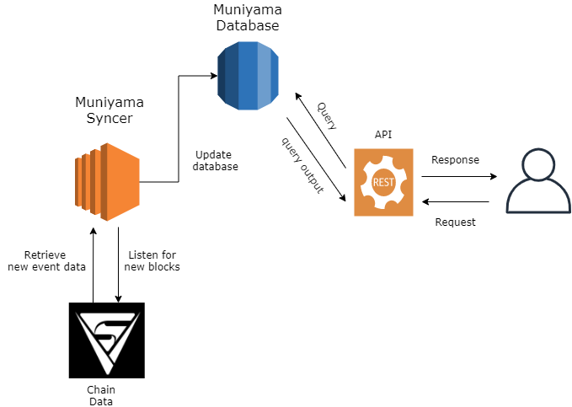
What Does Muniyama do?
Muniyama uses the Muniyama-Syncer to listen to Sovryn contract events occuring in RSK mainnet using the event's topic values.
Syncer updates the postgres database when new event data are retrieved.
The event data indexed in muniyama database(postgres) can be accessed through the REST API

Slide 5
Muniyama syncer
Does continuous synchronization of chain data with the postgres database(muniyama database).
Runs on AWS EC2 t2.micro instance
Uses the sovryn public node (https://mainnet.sovryn.app/rpc) for listening for new blocks
Uses Covalent API to retrieve new event data by their topic[0] values

Slide 6
Muniyama database
A postgres database
Hosted in Amazon RDS
Contains tables to hold chain data for each event defined in sovryn contracts.
Table names are same as event names
Attribute names are same as event parameters
Indexed with block numbers and transaction hash

Slide 7
Muniyama Api
REST API
Hosted in AWS elastic beanstalk
Base URL: http://muniyamaapi-env.eba-dwmnzgre.us-east-2.elasticbeanstalk.com
Paths:
/events/{eventName} :
The path parameter eventName is name of the event whose data is to be queried.
Query Parameters(all are optional):
fromBlock: block number of block to begin querying
toBlock: block number of block to end querying
Event parameters: event parameters to be used for filtering data. Values must be enclosed within square brackets [] and separated by commas

Slide 8
Resources used
RESOURCE | PURPOSE
AWS EC2 t2.micro instance | Hosts Muniyama-syncer
Amazon RDS postgres instance | Hosts Muniyama Database
Elastic Beanstalk | Hosts the REST API
Sovryn public node (mainnet.sovryn.app/rpc) | Listen for new blocks
Covalent API | Get event data by topic[0] values

Slide 9
FUTURE WORKS
Merkle Proofs have to be provided so that third-parties can verify the integrity of data that was pulled off-chain and indexed in Muniyama Database. These proofs are a necessity to ensure trustless-ness
Some of the events given in https://github.com/DeveloperInProgress/muniyama-api#muniyama-database are marked as coming soon. They are yet to be indexed because their definition were not provided publicly in the sovryn contracts at time of initially indexing the chain data in Muniyama.
Data can be processed further into data that might be useful for the third parties. These processed data can be made available through separate endpoints in REST API.
A proper domain that is relevant and can be easily remembered must be bought for this API.

Slide 10
THANK YOU
Naveen V
velnaveen99@gmail.com
Twitter : @Naveenvemy
BitClout : @naveenv

